Slide 1
Road Anomaly Detection using Machine Learning
Project iRoads
140011X: H. M. A. Abeywardana
140014J: U. M. J. Abeywickrama
140024N: P. T. Amarasinghe
140323F: R. P. D. Kumarasinghe

Slide 2
Introduction
Part of the ongoing final year project “iRoads - smartphone-based road condition monitoring solution”
Our main objective is to Identify road anomalies using machine learning.
Potholes
Bumps
Mobile phone sensor data and vehicle speed used as features.

Slide 3
Methodology
Feature Extraction.
Oversampling
Random Forest Classifier
Grid Search Parameter Tuning
Cross Validation

Slide 4
Feature Extraction - Dataset
Fields
acceX
acceX_raw
acceY
acceY_raw
acceZ
acceZ_raw
anomaly
dataTyp
gpsSpeed
Anomaly is the target we need to predict.
Anomaly can have 3 values
N ( Normal )
P ( Pothole )
B ( Bump )
Concerned columns from these for machine learning process are,
acceX, acceX_raw, acceY, acceY_raw, acceZ, acceZ_raw, Anomaly, gpsSpeed
Id
imei
journeyID
lat
Lon
obdRpm
obdSpeed
time
timeCount

Slide 5
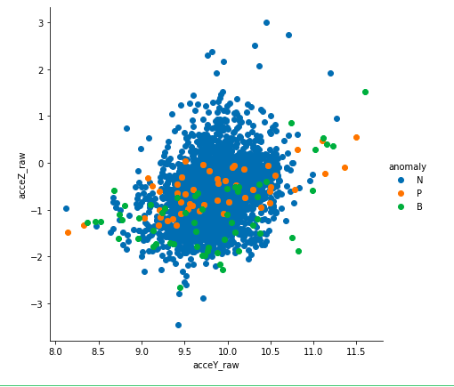
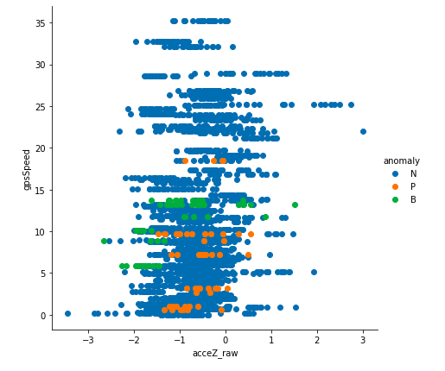
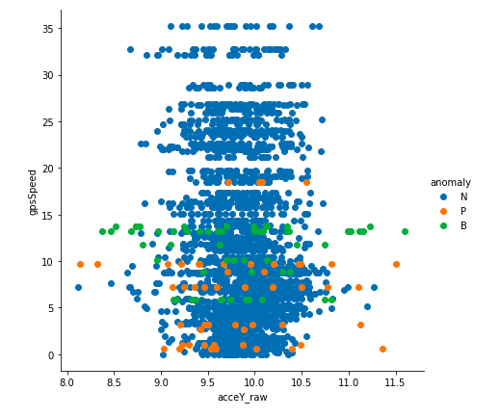
Feature Extraction - Correlation Analysis
Correlations of anomalies with acceleration Y, Z and Gps Speed
Only ‘gpsSpeed’ seems to be correlates with ‘anomaly’.

Slide 6
Random Forest Classifier
A bagging algorithm.
Creates different classifiers to represent different parts of the training set and give average prediction of submodels.
Performs well in small data sets.
Overcome the issue of insufficient data for a neural network.

Slide 7
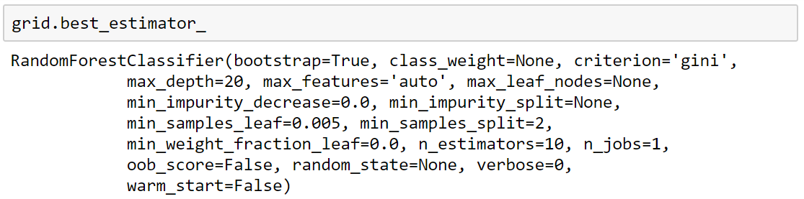
Grid Search Parameter Tuning
Parameter values given from the ‘Grid search’ estimator were used as the parameters for the Random Forest Classifier model.

Slide 8
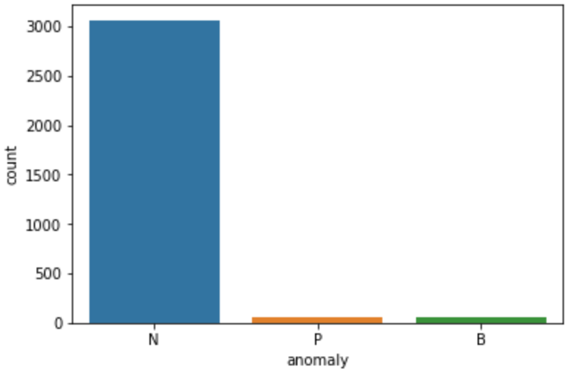
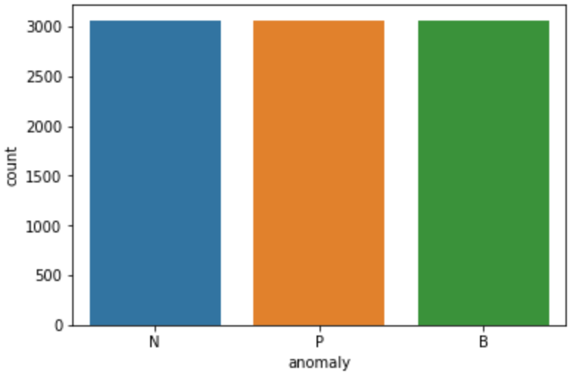
Oversampling with SMOTE
Before
After
Random Oversampling could cause overfitting of the model.
Applying Synthetic Minority Oversampling Technique for the minority classes helped to remove the skewness from the dataset without overfitting.

Slide 9
Cross Validation
Couldn’t use an approach like ‘train_test_split’ due to characteristics of the dataset.
Used stratified cross validation to fairly take data points from each classes when creating folds for cross validation.
Number of folds for cross validation | Mean of cross validation scores
3 | 0.883291389624155
10 | 0.9021864554725255
20 | 0.9077646209999152
30 | 0.9094855849567444
Number of folds for cross validation | Mean of cross validation scores
3 | 0.4478605935127674
10 | 0.7448809523809524
20 | 0.7252272727272726
30 | 0.7857142857142857
gpsSpeed vs anomaly
gpsSpeed, acceY_raw vs anomaly

Slide 10
Conclusion
Correlation analysis
Observed that only vehicle speed correlate with the target.
Oversampling the minority classes.
Preventing classifier from investing lot of effort on tuning parameters to discriminate between the classes.
Classifier Model
Random Forest classifier does not need large data set as for training a neural network.
Cross validation
Suitable for for small size data sets to validate accuracy without expending part of the dataset.

